Slide 1



GrabCut Interactive Foreground Extraction using Iterated Graph Cuts Carsten Rother Vladimir Kolmogorov Andrew Blake Microsoft Research Cambridge-UK
Notes:
Welcome. I will present Grabcut – an Interactive tool for foreground extraction.

Slide 2
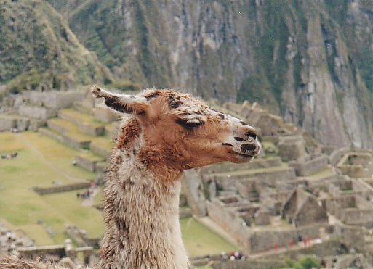
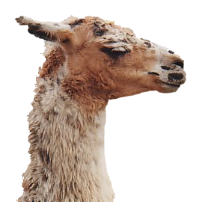

Problem
Fast & Accurate ?
GrabCut – Interactive Foreground Extraction 2
Notes:
State the problem. Image object to extract and simple tool which gives high quality results with an alpha matte and even works for the case of camoflage.

Slide 3

Graph Cuts modelling in images
Foreground (source)
Image
Min Cut
Background (sink)
Cut: separating source and sink; Energy: collection of edges
Min Cut: Global minimal enegry in polynomial time
GrabCut – Interactive Foreground Extraction 5
Notes:
Optimization engine we use Graph Cuts. By know everybody should know what graph cut is. IN case you missed it here is a very brief introduction.
To image. 3D view. First task to construct a graph.
All pixels on a certain scanline. Just a few of them.
Next step introduce artificial nodes. fgd and background.
Edges – contrast. Boundary is quite likely between black and white.
Min Cut - Minimum edge strength.

Slide 4
Graph Cuts for foreground extraction
Foreground (source)
Assume we know foreground is white and background is black
Min Cut
Background (sink)
GrabCut – Interactive Foreground Extraction 5
Notes:
Optimization engine we use Graph Cuts. By know everybody should know what graph cut is. IN case you missed it here is a very brief introduction.
To image. 3D view. First task to construct a graph.
All pixels on a certain scanline. Just a few of them.
Next step introduce artificial nodes. fgd and background.
Edges – contrast. Boundary is quite likely between black and white.
Min Cut - Minimum edge strength.

Slide 5
Graph Cuts for foreground extraction
Foreground (source)
Assume we know foreground is white and background is black
Data term =
(cost of assigning label)
Regularization =
(cost of separating neighbors)
Min Cut
Background (sink)
GrabCut – Interactive Foreground Extraction 5
Notes:
Optimization engine we use Graph Cuts. By know everybody should know what graph cut is. IN case you missed it here is a very brief introduction.
To image. 3D view. First task to construct a graph.
All pixels on a certain scanline. Just a few of them.
Next step introduce artificial nodes. fgd and background.
Edges – contrast. Boundary is quite likely between black and white.
Min Cut - Minimum edge strength.

Slide 6
Graph Cuts for foreground extraction
Foreground (source)
Assume we know foreground is white and background is black
Data term = whiteness
(cost of assigning label)
Regularization =
(cost of separating neighbors)
Min Cut
Background (sink)
GrabCut – Interactive Foreground Extraction 5
Notes:
Optimization engine we use Graph Cuts. By know everybody should know what graph cut is. IN case you missed it here is a very brief introduction.
To image. 3D view. First task to construct a graph.
All pixels on a certain scanline. Just a few of them.
Next step introduce artificial nodes. fgd and background.
Edges – contrast. Boundary is quite likely between black and white.
Min Cut - Minimum edge strength.

Slide 7
Graph Cuts for foreground extraction
Foreground (source)
Assume we know foreground is white and background is black
Data term = whiteness
(cost of assigning label)
Regularization = color match
(cost of separating neighbors)
Min Cut
Background (sink)
GrabCut – Interactive Foreground Extraction 5
Notes:
Optimization engine we use Graph Cuts. By know everybody should know what graph cut is. IN case you missed it here is a very brief introduction.
To image. 3D view. First task to construct a graph.
All pixels on a certain scanline. Just a few of them.
Next step introduce artificial nodes. fgd and background.
Edges – contrast. Boundary is quite likely between black and white.
Min Cut - Minimum edge strength.

Slide 8
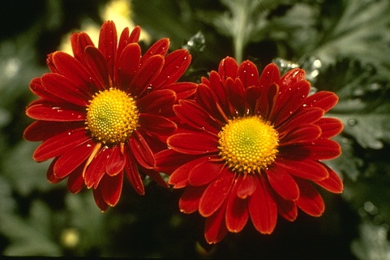

We are all set now !
?
User Initialisation
Learn foreground color model
Graph cuts to infer the foreground
GrabCut – Interactive Foreground Extraction 6
Notes:
We extended there work in the following way. IGC – Technique like EM – switch between 2 optimization problems.
GC does not consider all other parameters. Init by user.

Slide 9
Iterated Graph Cuts
?
User Initialisation
Learn foreground color model
Graph cuts to infer the foreground
GrabCut – Interactive Foreground Extraction 6
Notes:
We extended there work in the following way. IGC – Technique like EM – switch between 2 optimization problems.
GC does not consider all other parameters. Init by user.

Slide 10




Iterated Graph Cuts
Guaranteed to converge
1
2
3
4
Result
Energy after each Iteration
GrabCut – Interactive Foreground Extraction 7
Notes:
Iterations are not shown to the user; Converges: proof in the paper.

Slide 11
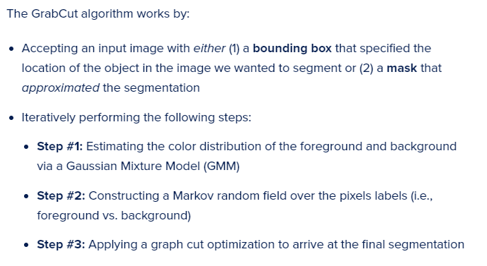
GrabCut algorithm

Slide 12
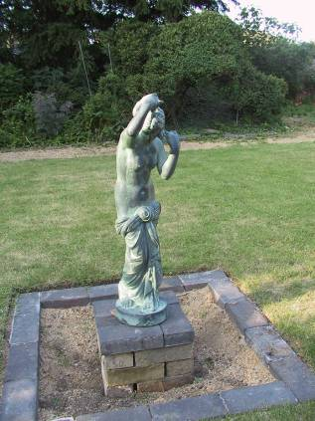
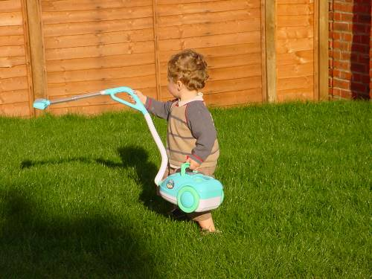
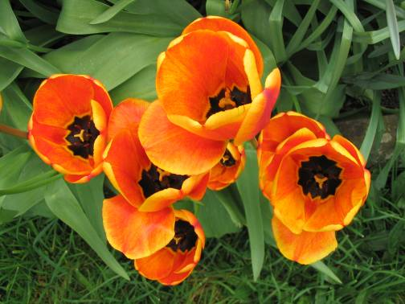
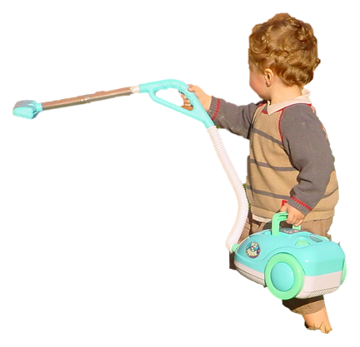
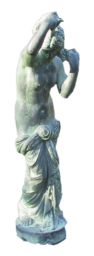
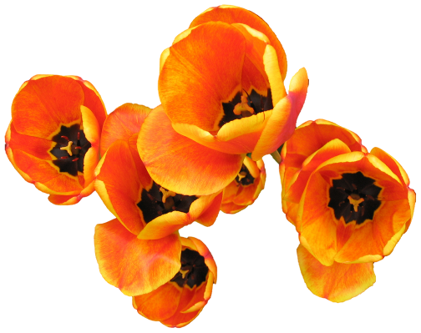
Moderately straightforward examples
… GrabCut completes automatically
GrabCut – Interactive Foreground Extraction 10
Notes:
Moderately straightforward examples- after the user input automnatically

Slide 13
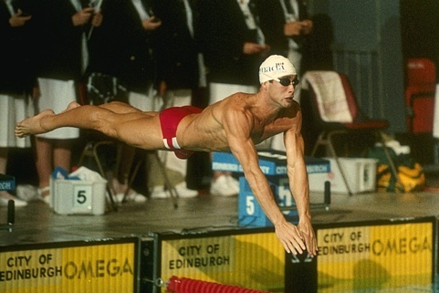
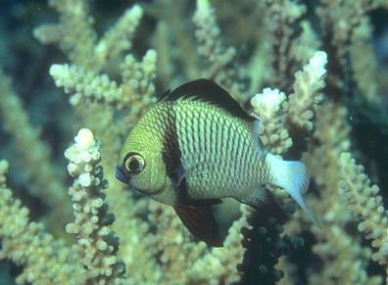
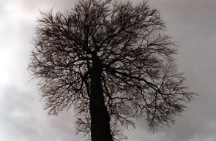
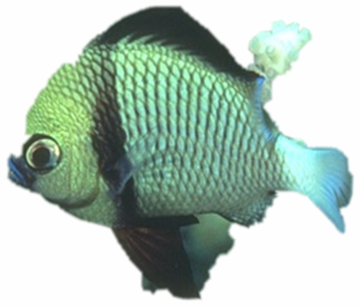
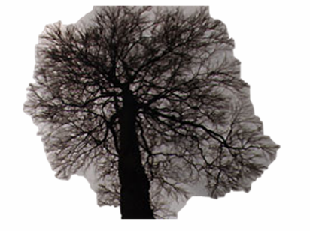
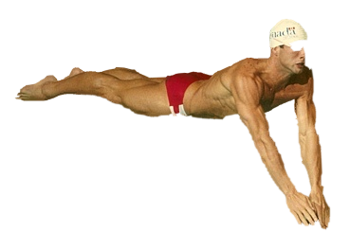
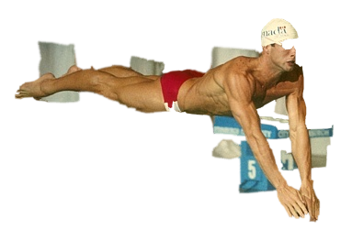
Difficult Examples
Camouflage &
Low Contrast
Fine structure
No telepathy
Initial Rectangle
Initial Result
GrabCut – Interactive Foreground Extraction 11
Notes:
You might wonder when does it fail. 4 cases. Low contrats – an edge not good visible

Slide 14
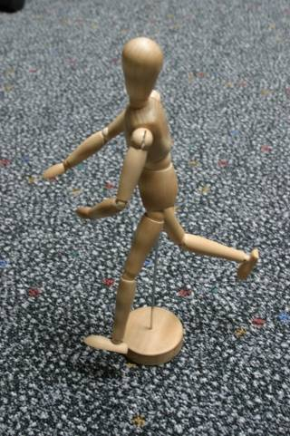
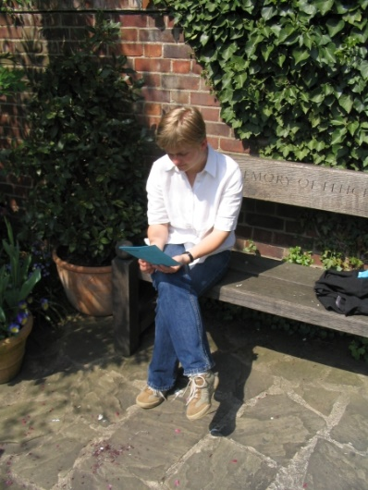
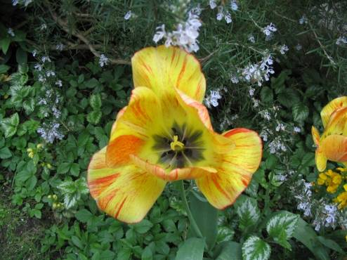
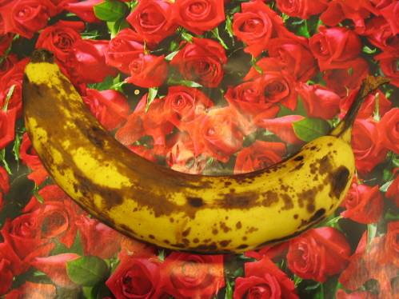





Evaluation – Labelled Database
Available online: http://research.microsoft.com/vision/cambridge/segmentation/
GrabCut – Interactive Foreground Extraction 12
Notes:
Labeled data base 70 images . availoable online. Different scenarios – simple and ifficult shapes and colour.

Slide 15
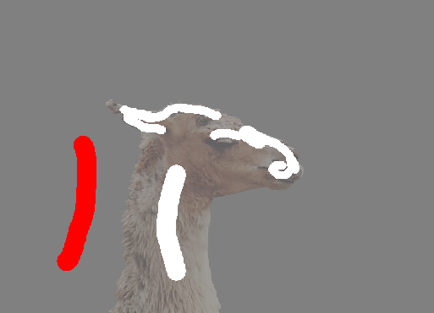
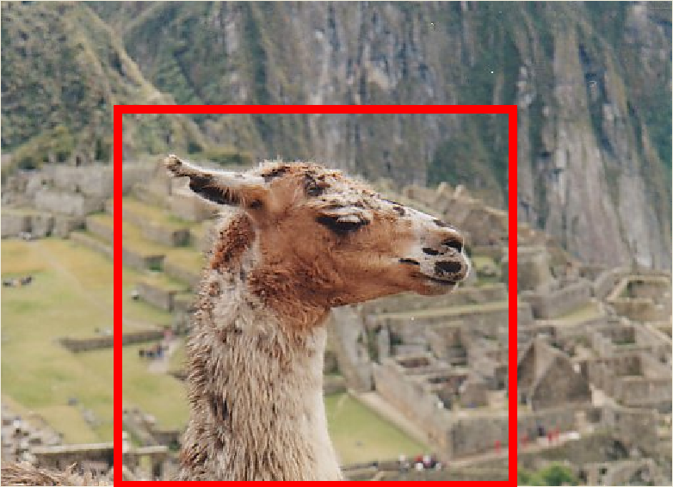
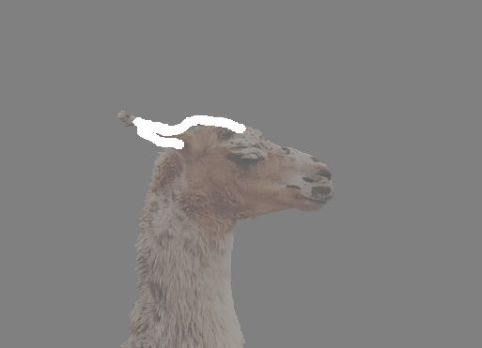
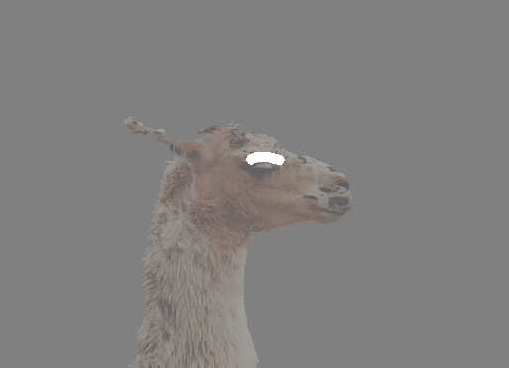
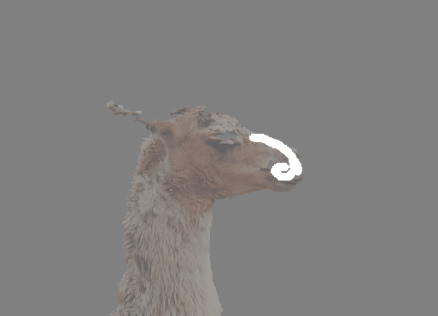
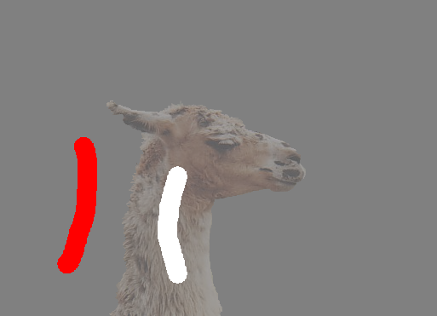
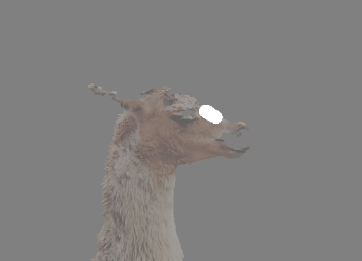
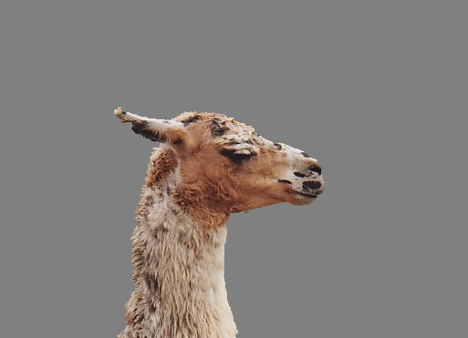
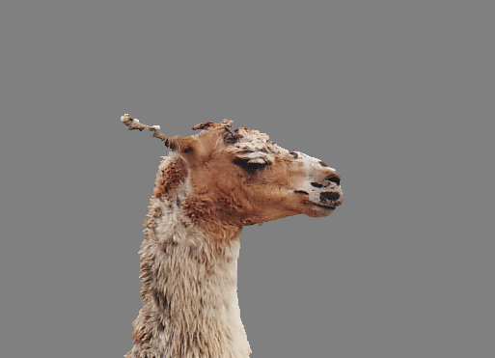

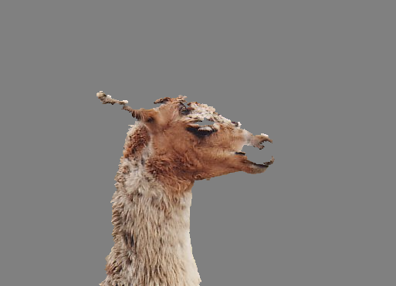
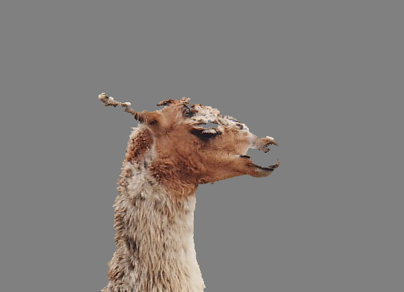

Comparison
Boykov and Jolly (2001)
GrabCut
User Input
Result
Error Rate: 1.87%
Error Rate: 1.81%
Error Rate: 1.32%
Error Rate: 1.25%
Error Rate: 0.72%
Error Rate: 0.72%
GrabCut – Interactive Foreground Extraction 13
Notes:
Databsed used to compare to BJ. Re-implented their method. Simpler same error rate

Slide 16
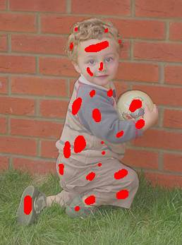
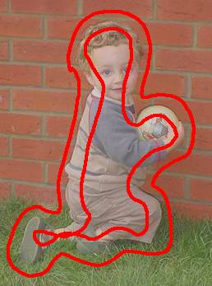
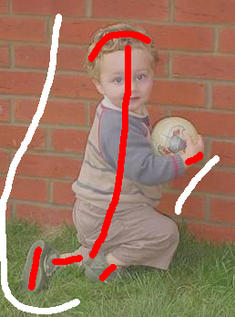
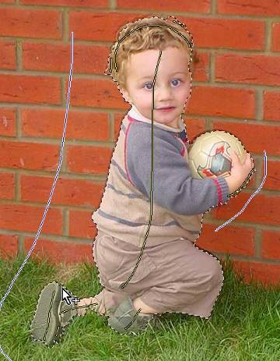
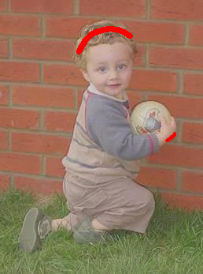
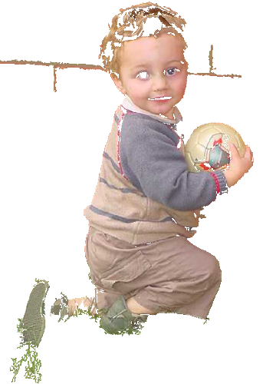
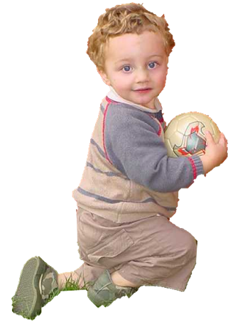
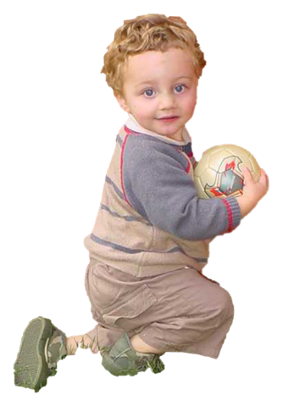
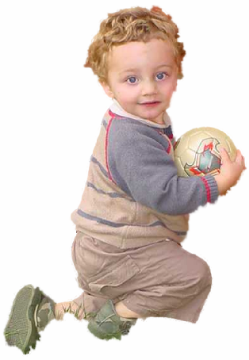
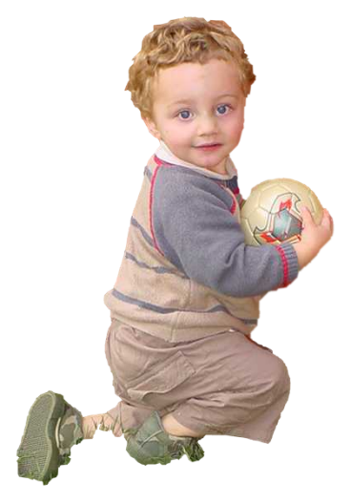
Summary
Magic Wand (198?)
Intelligent Scissors Mortensen and Barrett (1995)
Graph Cuts Boykov and Jolly (2001)
LazySnapping Li et al. (2004)
GrabCut Rother et al. (2004)
GrabCut – Interactive Foreground Extraction 22
Notes:
Finally – number of tools: certain scenarios.
what does the user want to do for segmentation –
Graph Cut – user input reduced and quality increases.

Slide 17
cv2.grabCut()
Syntax:
cv2.grabCut(image, mask, rectangle, backgroundModel, foregroundModel, iterationCount[, mode])
Parameters:
image: Input 8-bit 3-channel image.
mask: Input/output 8-bit single-channel mask. The mask is initialized by the function when mode is set to GC_INIT_WITH_RECT. Its elements may have one of following values:
GC_BGD defines an obvious background pixels.
GC_FGD defines an obvious foreground (object) pixel.
GC_PR_BGD defines a possible background pixel.
GC_PR_FGD defines a possible foreground pixel.

Slide 18
cv2.grabCut()
Parameters:
rectangle: It is the region of interest containing a segmented object. The pixels outside of the ROI are marked as obvious background. The parameter is only used when mode==GC_INIT_WITH_RECT.
backgroundModel: Temporary array for the background model.
foregroundModel: Temporary array for the foreground model.
iterationCount: Number of iterations the algorithm should make before returning the result. Note that the result can be refined with further calls with mode==GC_INIT_WITH_MASK or mode==GC_EVAL.
mode: It defines the Operation mode. It can be one of the following:
GC_INIT_WITH_RECT: The function initializes the state and the mask using the provided rectangle. After that it runs iterCount iterations of the algorithm.
GC_INIT_WITH_MASK: The function initializes the state using the provided mask. Note that GC_INIT_WITH_RECT and GC_INIT_WITH_MASK can be combined. Then, all the pixels outside of the ROI are automatically initialized with GC_BGD.
GC_EVAL: The value means that the algorithm should just resume.

Slide 19
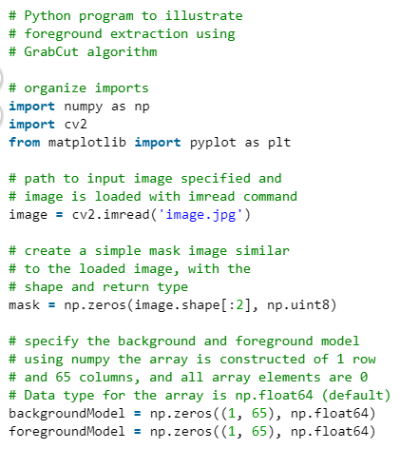
https://www.geeksforgeeks.org/python-foreground-extraction-in-an-image-using-grabcut-algorithm/

Slide 20
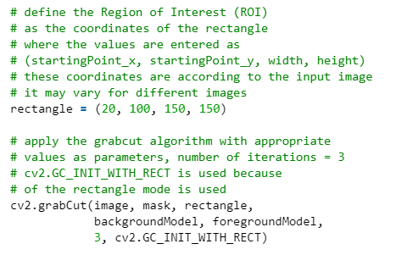
https://www.geeksforgeeks.org/python-foreground-extraction-in-an-image-using-grabcut-algorithm/

Slide 21
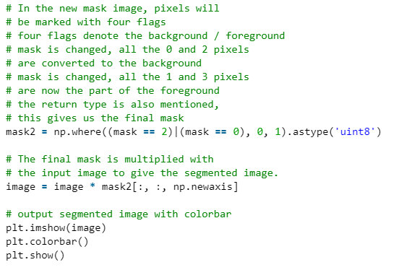
https://www.geeksforgeeks.org/python-foreground-extraction-in-an-image-using-grabcut-algorithm/

Slide 22
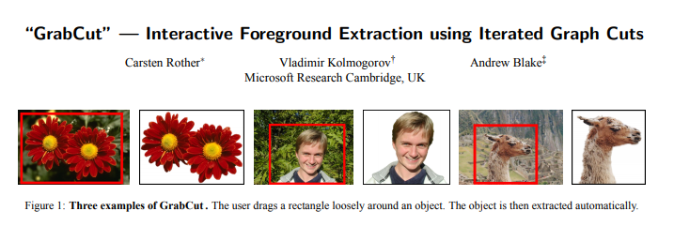
Tham khảo
https://www.pyimagesearch.com/2020/07/27/opencv-grabcut-foreground-segmentation-and-extraction/
https://docs.opencv.org/3.4/d8/d83/tutorial_py_grabcut.html
https://cvg.ethz.ch/teaching/cvl/2012/grabcut-siggraph04.pdf

Slide 23
def GraphSeg(path_filename, x, y, w, h):
img = cv2.imread(path_filename)
img = cv2.cvtColor(img, cv2.COLOR_BGR2RGB)
plt.imshow(img)
plt.show()
print(img.shape)
mask = np.zeros(img.shape[:2], np.uint8)
backgroundModel = np.zeros((1, 65), np.float64)
foregroundModel = np.zeros((1, 65), np.float64)
rectangle = (x, y, w, h)
cv2.grabCut(img, mask, rectangle,
backgroundModel, foregroundModel,
5, cv2.GC_INIT_WITH_RECT)
mask2 = np.where((mask == 2) | (mask == 0), 0, 1).astype('uint8')
res = img * mask2[:, :, np.newaxis]
plt.imshow(res)
plt.show()
res = cv2.cvtColor(res, cv2.COLOR_BGR2RGB)

Slide 24
Bài tập thực hành
Áp dụng thuật toán Graphcut cho các ảnh sau:
Lionel-Messi.jpg → chọn được Messi
Dogcat.jpg → Chọn cat hoặc dog
camourflage_xxxxxx.jpg → chọn object có trong ảnh

